Slide 1
Recommendation System
Zining Wang, Jiayu Yao, Qiyang Li

Slide 2
1. Intro & Background

Slide 3
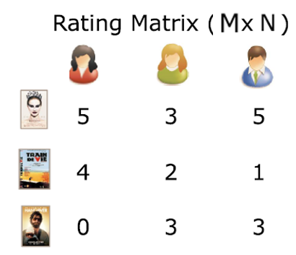
Recommendation System
Problem
User, Movie → Rating(1-5)
Given: History ratings dataset
Given: User & Movie information
Objective: Predict ratings and reduce error
Applications
Recommend different movies to different users
Find top 10 favorite movies
Personalized recommendations
?
Zining Wang, Jiayu Yao, Qiyang Li

Slide 4
Dataset
Dataset:
1 M dataset by Grouplens
6040 users, 3952 movies
User id, movie id, ratings
Additional user and movie information
Zining Wang, Jiayu Yao, Qiyang Li

Slide 5
2. Methods

Slide 6
Recommendation System
Methods:
Global average/Movie average/User Average
K Nearest Neighbor (KNN)
Singular Vector Decomposition (SVD)
XGBoost
Ensemble/Hybrid Recommendation System Methodology
Novel ideas..
Zining Wang, Jiayu Yao, Qiyang Li

Slide 7
Only Using Average...
Predict every rating by global average/movie average/user Average
Baseline Model

Slide 8
KNN

Slide 9
SVD
Simple SVD
Factorized the movie-user matrix
Impute missing values with average
SVD + bias
Incorporate user/movie bias
Randomly initialize matrices
Set default user/movie bias vectors
Use gradient descent to find P,Q and bias
Update for certain iterations

Slide 10
XGBoost

Slide 11
3.Experimental Results

Slide 12
Preprocessing Techniques
Dummy Code
Imputation

Slide 13
Train/Test Split
80% train, 20% test
Same train/test set for all methods
Why?

Slide 14
Evaluation Metrics
root mean square error (RMSE)
Why?
Notes:
Accuracy not precisely model errors(e.g. by scale..)

Slide 15
Plots

Slide 16
Result Comparison
Test RMSE
Simple SVD 0.9620
SVD + bias 0.8977

Slide 17
4.Discussion

Slide 18
Key Challenges
Preprocessing user/movie info
Deal with missing values
Defining distance metrics for KNN
Running time and complexity

Slide 19
Problems
How to get dummy variables for zip code?
Imputation for missing values
How to incorporate temporal information

Slide 20
Next step
Explore smart ways to preprocess data
Ensemble
Try advanced models (if we have time..)
Notes:
Takeaway
lessons

Slide 21
5.Q & A

Slide 22
Thank you!

Slide 23
Baseline: Global Mean Qiyang Li
KNN:
Just use global mean to guess...
test RMSE = 1.12
Zining Wang, Jiayu Yao, Qiyang Li

Slide 24
Baseline: KNN Jiayu Yao
KNN:
k = 100
test RMSE = 1.1177
Zining Wang, Jiayu Yao, Qiyang Li

Slide 25
Baseline: SVD
SVD:
k = numbers of eigen values we take
test RMSE = 0.9626
Zining Wang, Jiayu Yao, Qiyang Li

